Slide 1
COVID 19 Relief Goods dhl China Export Clearance document pre-Check process
DHL中国防疫物资出口清关单证要求及预审流程

Slide 2
Contents / 目录
China COVID-19 Relief Goods Scope
中国防疫物资范围
China COVID-19 Relief Goods Export Requirement Checklist
中国防疫物资清关要求检查单
China COVID19 Relief Goods Export Pre - Check Process / 出口报关单证预审资料流程
        ‘As-Is’ Pre-Check Process by Receiving Documents by Email
        通过电子邮件接收出口报关单证预审流程
        ‘To- be’ Pre-Check Process by Upload Documents into ‘Export Documents Pre-check’ Module on www.5idhl.com by Shipper
        发件人自行上传出口报关单证至www.5idhl.com ‘出口预审单’模块预审流程
      ‘To- be’ Pre-Check Process on ‘Export Documents Pre-check’ Module Implementation Schedule
      出口预审单模块预审流程实施计划

Slide 3
dhl China Export Clearance document pre-Check process on COVID-19 Relief Goods
DHL中国防疫物资出口清关单证预审流程
Scope of China COVID-19 Relief Goods / 中国防疫物资范围
COVID-19 Relief Goods under Announcement No. 5 by China Ministry of Commerce, China Customs and China FDA
中国商务部, 海关总署，国家药监局发布的5号公告对应的防疫物资
Surgical/medical face mask / Non Medical face mask 医用/非医用口罩
COVID-19 testing kit COVID19检测试剂
Ventilator 呼吸机
Infrared thermometer 红外体温仪
Protective Clothes 防护服
COVID-19 Relief Medical Goods items Under Announcement No 53 by China Customs
海关总署发布的53号公告对应的防疫物资
Surgical/Medical operation Cap 医用手术帽
Medical/Surgical Goggles 医用护目镜
Medical/Surgical Gloves 医用手套
Medical/Surgical Shoes Cover 医用鞋套
Patient Monitoring Devices 病员监护仪
Disinfectant Towel/Disinfectant 医用消毒巾/消毒剂

Slide 4
Contents / 目录
China COVID-19 Relief Goods Scope
中国防疫物资范围
China COVID-19 Relief Goods Export Requirement Checklist
中国防疫物资清关要求检查单
China COVID19 Relief Goods Export Pre - Check Process / 出口报关单证预审资料流程
        ‘As-Is’ Pre-Check Process by Receiving Documents by Email
        通过电子邮件接收出口报关单证预审流程
        ‘To- be’ Pre-Check Process by Upload Documents into ‘Export Documents Pre-check’ Module on www.5idhl.com by Shipper
        发件人自行上传出口报关单证至www.5idhl.com ‘出口预审单’模块预审流程
      ‘To- be’ Pre-Check Process on ‘Export Documents Pre-check’ Module Implementation Schedule
      出口预审单模块预审流程实施计划

Slide 5
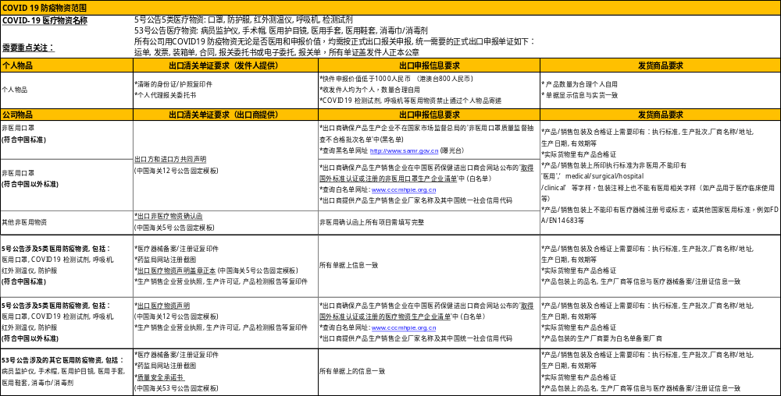
dhl China Export Clearance document pre-Check process on COVID-19 Relief Goods
DHL中国防疫物资出口清关单证预审流程
China COVID-19 Relief Goods Export Requirement Checklist (Chinese Version) 中国防疫物资清关要求检查单 (中文版）

Slide 6
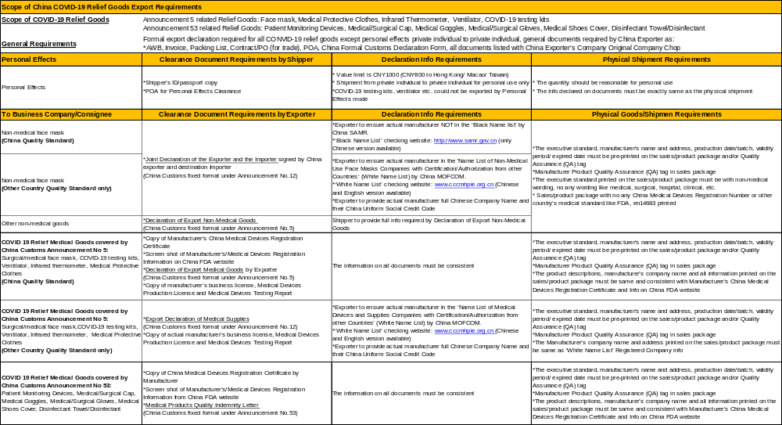
dhl China Export Clearance document pre-Check process on COVID-19 Relief Goods
DHL中国防疫物资出口清关单证预审流程
China COVID-19 Relief Goods Export Requirement Checklist (English Version) 中国防疫物资清关要求检查单 (英文版）

Slide 7
Contents / 目录
China COVID-19 Relief Goods Scope
中国防疫物资范围
China COVID-19 Relief Goods Export Requirement Checklist
中国防疫物资清关要求检查单
China COVID19 Relief Goods Export Pre - Check Process / 出口报关单证预审资料流程
        ‘As-Is’ Pre-Check Process by Receiving Documents by Email
        通过电子邮件接收出口报关单证预审流程
        ‘To- be’ Pre-Check Process by Upload Documents into ‘Export Documents Pre-check’ Module on www.5idhl.com by Shipper
        发件人自行上传出口报关单证至www.5idhl.com ‘出口预审单’模块预审流程
      ‘To- be’ Pre-Check Process on ‘Export Documents Pre-check’ Module Implementation Schedule
      出口预审单模块预审流程实施计划

Slide 8
dhl China Export Clearance document pre-Check process on COVID-19 Relief Goods
DHL中国防疫物资出口清关单证预审流程
‘As-Is’ Pre-Check Process by receiving Documents by email
现有通过电子邮件接收出口报关单证预审资料流程
Prepare DHL HAWB by DHL Ecom Tool
使用DHL Ecom制单系统制作快递运单
Prepare China Customs required Formal Export Declaration documents for COVID19 Relief Goods
根据中国海关要求准备防疫物资出口报关单证
Shipper to send email to DHL China related export gateway clearance team for pre-check by attaching all documents/image for China Formal Export Customs Declaration
发件人通过电子邮件将防疫物资出口报关单证影像发至DHL中国出口口岸清关团队申请预审
DHL CN Export Clearance team to check info and documents received by email
DHL 中国相应出口口岸清关团队预审防疫物资出口报关单证
*Refer ‘COVID19 Relief Goods Export Clearance Checklist’
参考‘防疫物资申报核查清单’
*Email address to be provided by DHL courier or CS Service hotline based on origin location
DHL 派送员或客服根据发件地址提供预审电子邮箱
*Finish pre-check in 3 working days
3个工作日内完成预审
DHL China export gateway Clearance Liaison Agent reply by email to shipper to notice:
DHL中国出口口岸清关联络员通过电子邮件告知发件人：
Point out problem of the documents for correction and advise to resubmit pre-check
指出单证问题并告知修改完成后重新发送预审
Shipper to revise info/documents for China Formal Export Customs Declaration and resubmit pre-check request by Email
发件人完成修改出口报关单证后，再次通过电子邮件提交预审申请
Pass
pre-check
通过预审
否/NO
否/NO
DHL China export gateway Clearance Liaison Agent reply by email to shipper to notice:
DHL中国出口口岸清关联络员通过电子邮件告知发件人：
China Formal Export Customs Declaration documents passed pre-check
To Call DHL China service hotline 95380 or use DHL Ecom tool to arrange pickup
出口报关单证通过预审
拨打DHL中国客服热线95380或使用DHL Ecom工具安排预约取件
Shipper/Customer booking with DHL for pickup by
发件人/客户使用如下方式安排DHL取件预约
Call DHL CN service hotline 95380 or
via Ecom tool for pickup booking
拨打DHL CN 服务热线95380, 或
使用Ecom 工具安排预约
DHL Courier to check the physical shipment v.s the documents reviewed.
DHL派送员检查实际货物和所提交的审核通过的单证是否相符
是/Yes
是/Yes
DHL Pickup Shipment
DHL 派送员完成取件

Slide 9
dhl China Export Clearance document pre-Check process on COVID-19 Relief Goods
DHL中国防疫物资出口清关单证预审流程
‘To- be’ Pre-Check Process by uploading Documents in ‘Export Documents pre-check’ module on www.5idhl.com
更新的发件人上传出口报关单证至www.5idhl.com 出口预审单模块预审资料流程
Prepare DHL HAWB by DHL Ecom Tool
使用DHL Ecom制单系统制作快递运单
Prepare China Customs required Formal Export Declaration documents for COVID19 Relief Goods
根据中国海关要求准备防疫物资出口报关单证
Shipper to provide shipment info and upload all documents/image for China Formal Export Customs Declaration into ‘Export Documents pre-check’ module under www.5idhl.com
登录www.5idhl.com‘出口预审单’模块填写货物信息并上传防疫物资出口报关单证影像
DHL CN Export Clearance team to check info and documents uploaded
DHL 中国相应出口口岸清关团队预审防疫物资出口报关单证
*Refer ‘COVID19 Relief Goods Export Clearance Checklist’
参考‘防疫物资申报核查清单‘
*Finish pre-check in 3 working days
3个工作日内完成预审
*Refer ‘COVID19 Relief Goods Export Clearance Checklist’
参考‘防疫物资申报核查清单’
*Refer user Manuel of ‘Export Documents pre-Check’ module
参见出口预审单使用手册
DHL China export gateway Clearance Liaison Agent reply by email &message to shipper to notice:
DHL中国出口口岸清关联络员通过电子邮件和短信告知发件人：
To log on ‘Export Documents pre-check’ module to update/revise info or documents
登录‘出口预审单’模块修改相关信息或文件
Shipper to revise info or documents in ‘Export Documents pre-check’ module and resubmit for checking
发件人登陆‘出口预审单’模块修改信息或更新出口报关单证后，再次提交预审申请
Pass
pre-check
通过预审
否/NO
否/NO
DHL China export gateway Clearance Liaison Agent reply by email &message to shipper to notice:
DHL中国出口口岸清关联络员通过电子邮件和短信告知发件人：
China Formal Export Customs Declaration documents passed pre-check
To Call DHL China service hotline 95380 or use DHL Ecom tool to arrange pickup
出口报关单证通过预审
拨打DHL中国客服热线95380或使用DHL Ecom工具安排预约取件
Shipper/Customer booking with DHL for pickup by
发件人/客户使用如下方式安排DHL取件预约
Call DHL CN service hotline 95380 or
via Ecom tool for pickup booking
拨打DHL CN 服务热线95380, 或
使用Ecom 工具安排预约
DHL Courier to check the physical shipment v.s the documents reviewed.
DHL派送员检查实际货物和所提交的审核通过的单证是否相符
是/Yes
是/Yes
DHL Pickup Shipment
DHL 派送员完成取件

Slide 10
Contents / 目录
China COVID-19 Relief Goods Scope
中国防疫物资范围
China COVID-19 Relief Goods Export Requirement Checklist
中国防疫物资清关要求检查单
China COVID19 Relief Goods Export Pre - Check Process / 出口报关单证预审资料流程
        ‘As-Is’ Pre-Check Process by Receiving Documents by Email
        通过电子邮件接收出口报关单证预审流程
        ‘To- be’ Pre-Check Process by Upload Documents into ‘Export Documents Pre-check’ Module on www.5idhl.com by Shipper
        发件人自行上传出口报关单证至www.5idhl.com ‘出口预审单’模块预审流程
      ‘To- be’ Pre-Check Process on ‘Export Documents Pre-check’ Module Implementation Schedule
      出口预审单模块预审流程实施计划

Slide 11
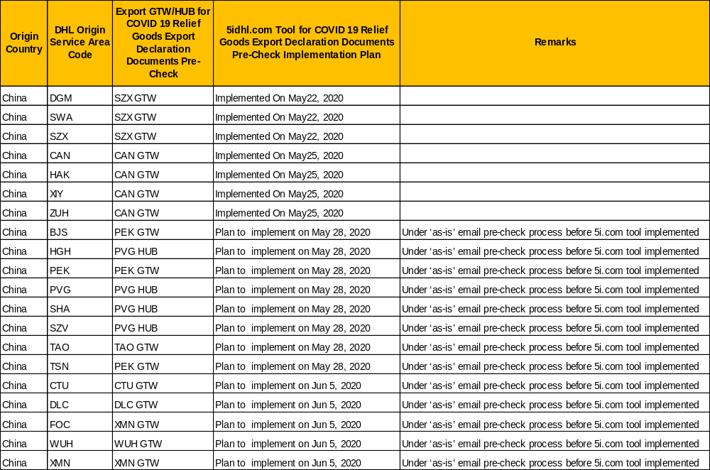
dhl China Export Clearance document pre-Check process on COVID-19 Relief Goods
DHL中国防疫物资出口清关单证预审流程
To- be Pre-Check Process on ‘Export Documents pre-check’ module on www.5idhl.com implementation schedule
www.5idhl.com 出口预审单模块实施计划

Slide 12
Thank you for supporting

